Slide 1
They Hunger from the satellites
Introducing…

Slide 2
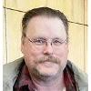
Drew jensen
Data Dictionary Visionary a.k.a The Mad Columnist
Height: Tall Weight: ??? Weapon of Choice: His mind and side arm pistol Special Trait: Constructed and retained our data dictionary Goals: Growth and success with the moon bases Family: Safe on Earth
Drew joined the Technicians after solidifying his knowledge with the data we almost lost.

Slide 3
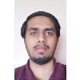
Muhammad Bilal
ERD Designer a.k.a. The Relationship Expert
Height: Average Weight: ??? Weapon of Choice: Long-barrel Rifle Special Trait: Established relationships with newly acquired data Goals: Find his place amongst the moon base Family: Safe on Earth
Muhammad joined the Technicians after establishing newfound data with already current research.

Slide 4
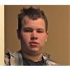
Caleb halvorson
Database Engineer a.k.a The Cog of Creation
Height: Average Weight: ??? Weapon of Choice: SMG/Pistol side-arm Special Trait: Operating and maintaining a structurally unsound database Goals: To survive the moon base operation Family: Located on LightSideB2 Basecamp
Caleb joined the Technicians after protecting and improving a stable data environment.

Slide 5

Joshua tiemens
Communicator
a.k.a. The Deranged Storyteller
Height: Tall Weight: ??? Weapon of Choice: Sniper Rifle Special Trait: Radio communications and unparallel stories to tell Goals: To write a book covering the events of this mission Family: Missing after DarkSide attack
Joshua impeded his position with the Technicians after establishing communications with Earth.

Slide 6
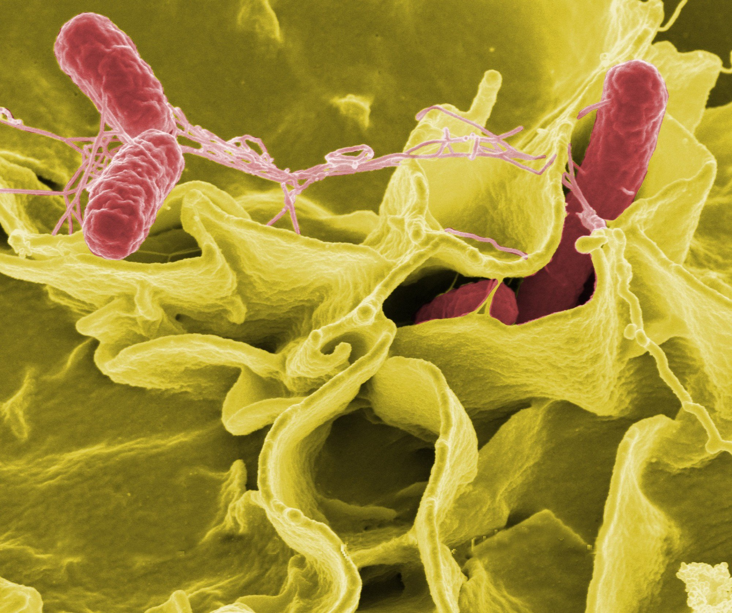
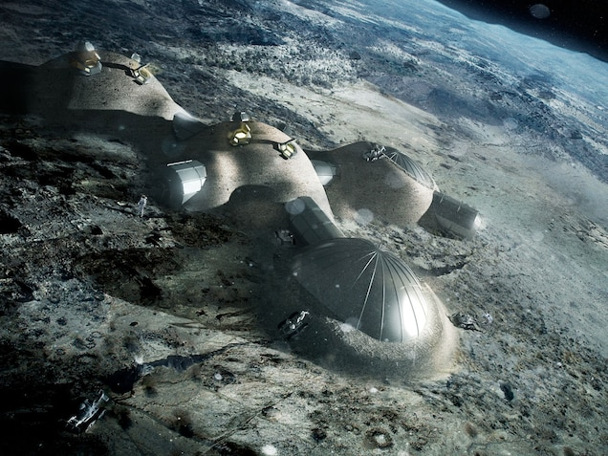
Events thus transpired
Venture to the dark side has proven dangerous
A foreign enemy we named The Demshi destroyed our technologies and data
Transportation to Earth was destroyed
Problematic disease turning humans into mindless, aggressive threats
Resources are compromised

Slide 7

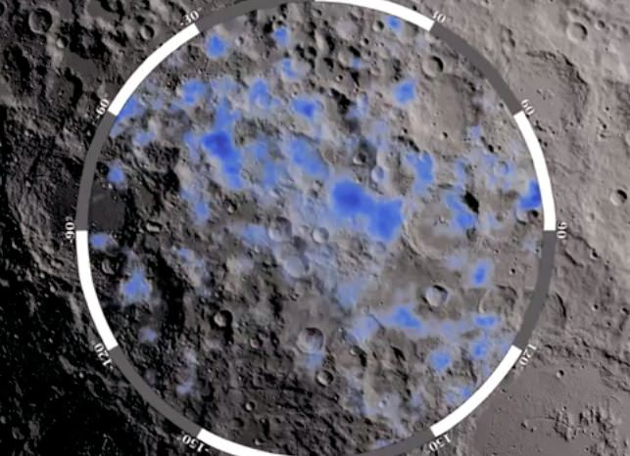
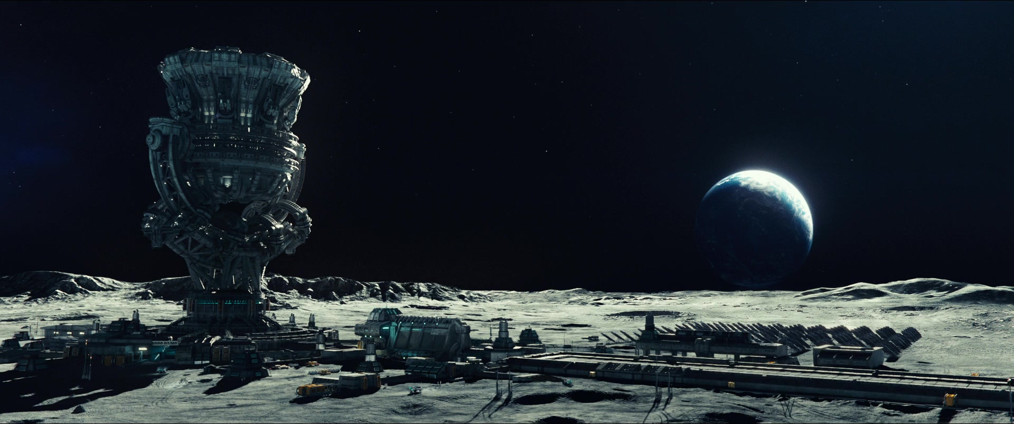
Our control on data
Our data originally tracked resources of production
Our goods had a consistent transfer rate
Productivity reports proved resource promise

Slide 8
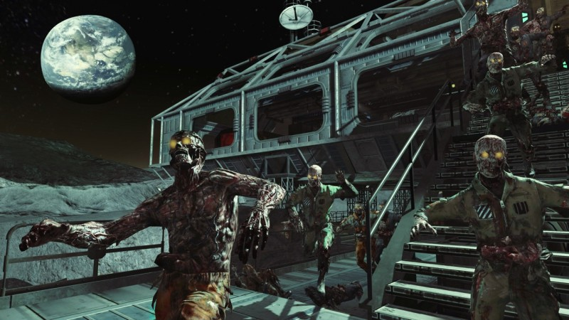
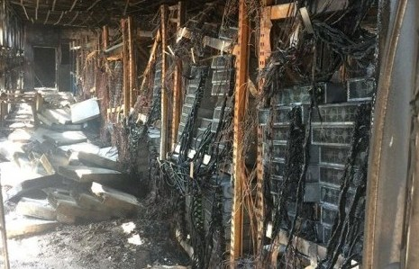

Our disaster
Majority of our systems have suffered great damage
Infected rate continues to grow, and vaccine studies haven’t progressed
Main mission is still a priority
Trade routes have reduced
Bases are being sieged by the infected

Slide 9
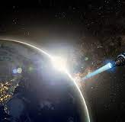
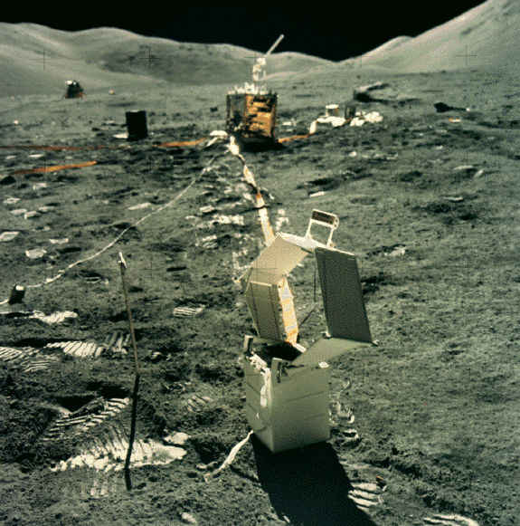
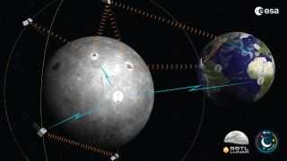
Our focus
Tracking infected and their attributes
Tracking resources
Tracking Miners, Growers, Scientists, and Military
Tracking base operations and hostile locations
Tracking colonists and skills
Population control

Slide 10
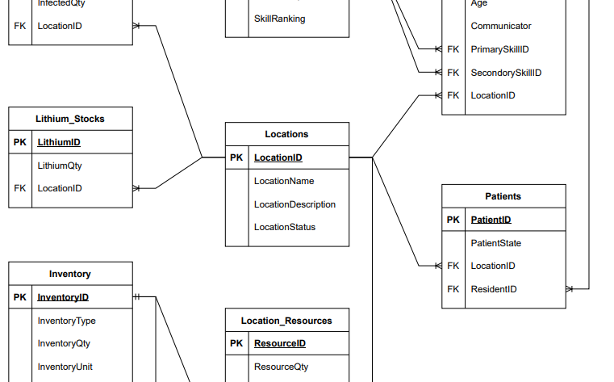
ERD design
Keeping our relationships up to date and current
Producing accurate results of tracking
Constantly updating with new information provided
Maintaining unique keys to combine important data

Slide 11
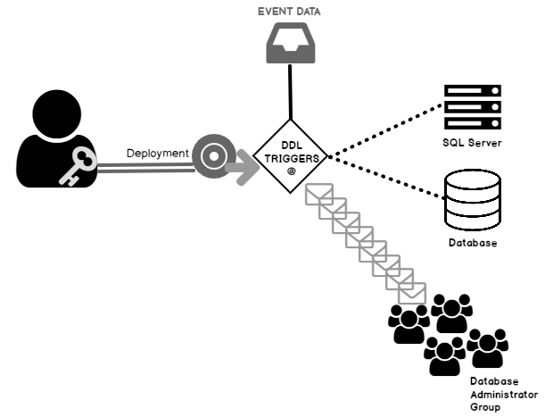
What makes you trigger?

Slide 12
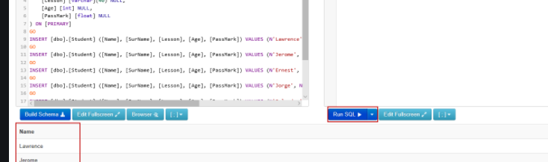

Query this
What information matters
How to display what we need
Where does our strengths and weaknesses display
How strong is our data

Slide 13
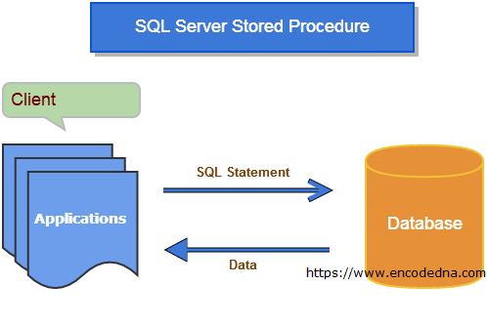
Storing our procedures
Improving our design and procedures will produce rapid results and populate required data to consistently support our operations on the moon.
Our operations rely on the information we can transpire to our leaders.

Slide 14
Fill this with Group timeline/policies

